Slide 1
Ramulator 2.0 Summary

Slide 2
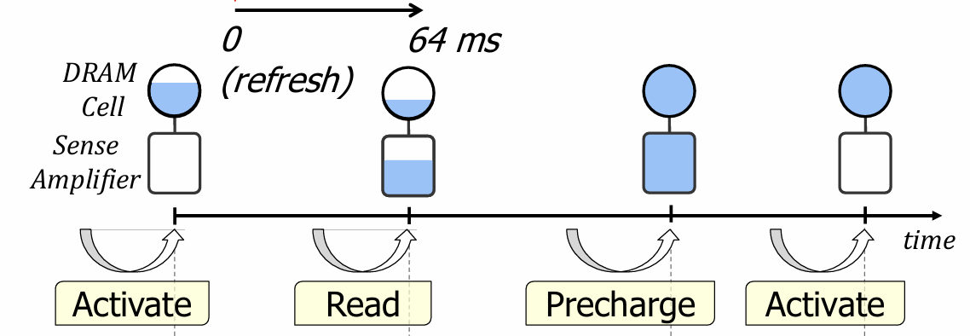
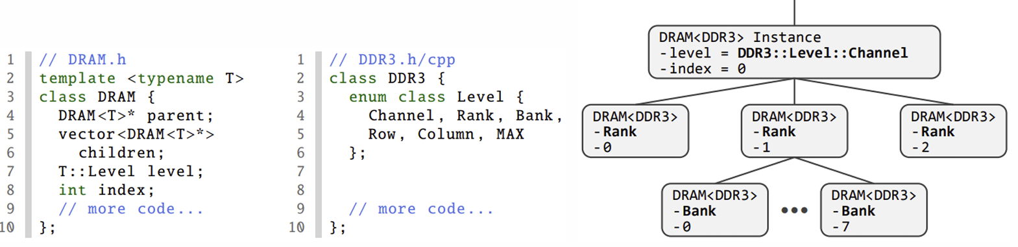

ADFS
DRAM Operations & States
Main DRAM states
Activate
Read
Precharge

Slide 3
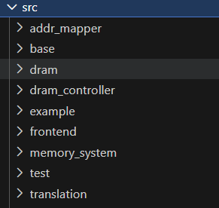
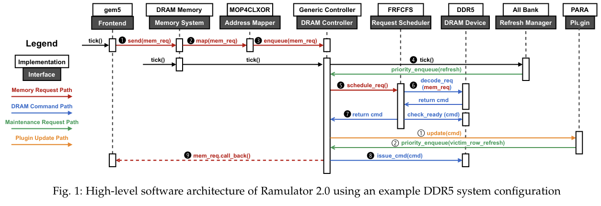
src files <=> DRAM Operation
Simulation Configuration
Notes:
1. Requests are sent: Front-end(trace file)에서 메모리 Request를 보냄
2. Memory Addresses are Mapped: Address Mapper가 Request Address를 DRAM 구조에 맞게 변환
3. Enqueue: DRAM Ctrlr의 Buffer에 Request를 넣음
4. DRAM Ctrlr - Ticking Refresh Manager: Ctrlr가 Refresh Manager를 호출해 high-priority maintenance request(ex. Refresh)을 추가
5. DRAM Ctrlr - Request Scheduling: Request Scheduler에게 최적의 Request을 선택하라고 요청
6. DRAM Device가 Request 확인: Scheduler가 DRAM Device Model을 참조해 적합한 Command를 Decode
7. Issue Command: DRAM Ctrlr가 DRAM Command를 보냄
8. Updates the behavior and timing information: DRAM Command Issue시 State & Timing이 Update
9. Notify the frontend: Memory Request가 끝나면 callback으로 frontend에 알림

Slide 4
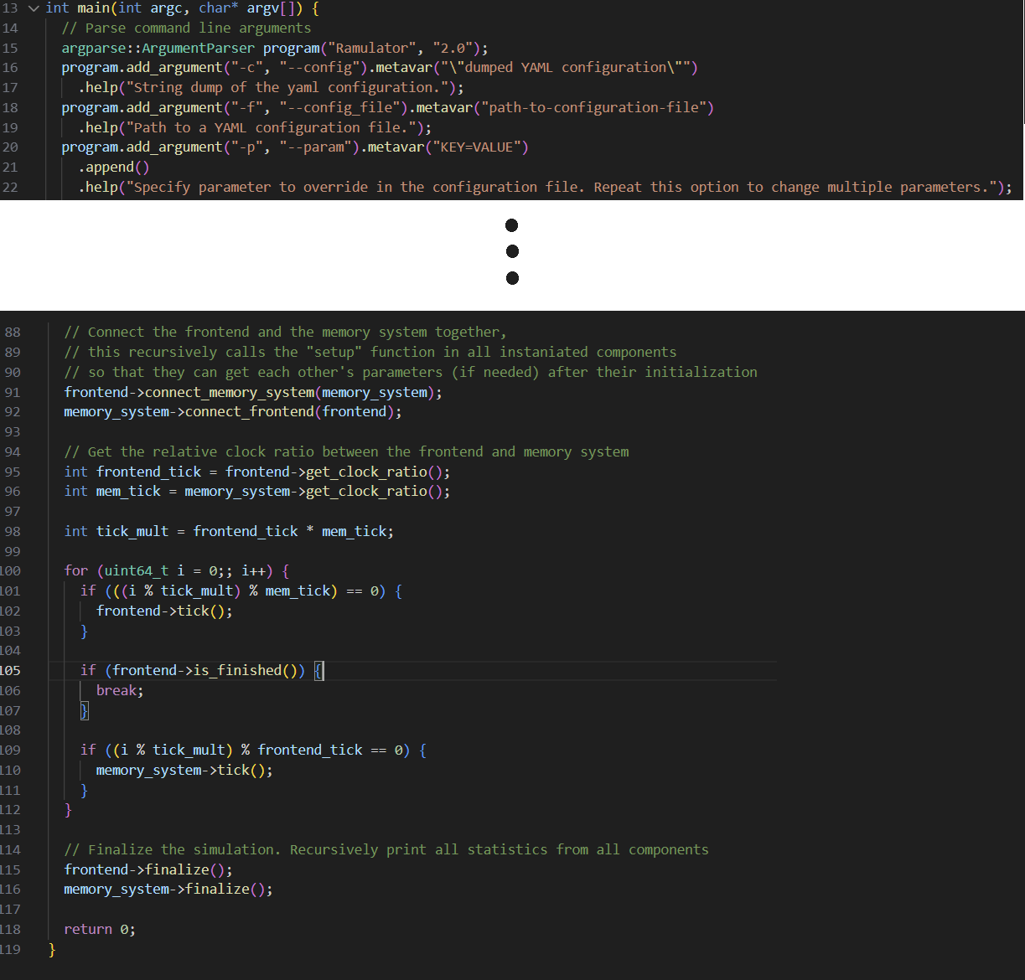
main function
main.cpp
main.cpp
Argument 받는 부분
Options
-c: commandline dump
-f: YAML document
-p: overriding parameters in a YAML document
Long for loop를 통한 tick() 기반 simul
frontend(core)가 발행한 예상 instructions들을 모두 처리시 is_finished()가 true가 됨

Slide 5
yaml file
example_config.yaml
main.cpp
Argument 받는 부분
Options
-c: commandline dump
-f: YAML document
-p: overriding parameters in a YAML document
Long for loop를 통한 tick() 기반 simul

Slide 6
src/base folder
base
abcd

Slide 7
src/base folder
base
abcd

Slide 8
src/base folder
base
abcd

Slide 9
src/frontend folder
frontend
abcd

Slide 10
src/frontend folder
frontend
abcd

Slide 11
src/frontend folder
frontend
abcd

Slide 12
src/memory_system folder
memory_system
abcd

Slide 13
src/memory_system folder
memory_system
abcd

Slide 14
src/addr_mapper folder
addr_mapper
abcd

Slide 15
src/addr_mapper folder
addr_mapper
abcd

Slide 16
src/translation folder
translation
abcd

Slide 17
src/translation folder
translation
abcd

Slide 18
src/translation folder
translation
abcd

Slide 19
src/dram folder
dram
abcd

Slide 20
src/dram folder
dram
abcd

Slide 21
src/dram folder
dram
abcd

Slide 22
src/dram_controller folder
dram_controller
abcd

Slide 23
src/dram_controller folder
dram_controller
abcd

Slide 24
src/dram_controller folder
dram_controller
abcd

Slide 25
src/dram_controller folder
dram_controller
abcd

